Slide 1

AUCTION MANAGEMENT PLATFORM
SOA Project Review-2
1st October, 2026
 | Under the Guidance of Mrs. E. Uma Shankari Department of Computer Science and Engineering, KLH CSE Bowrampet Campus
Team Members Masuma Fathema – 2420030400 Avinash Yarukala – 2420030568

Slide 2
PROBLEM STATEMENT
Traditional auctions are limited by geographical constraints.
Lack of transparency can lead to bidding disputes.
Manual coordination between sellers and bidders is inefficient.
Real-time bid tracking and payment settlement can be delayed.
There is a need for a secure, centralized and transparent online auction system.

Slide 3
OBJECTIVES
Develop a full-stack web-based auction platform.
Allow sellers to list items and schedule auctions.
Enable bidders to participate in real-time competitive bidding.
Implement a Bidding Engine with minimum bid-increment validation.
Support automated/proxy bidding.
Implement role-based access for buyers, sellers and administrators.
Automate payment, invoice generation and notifications.
Provide an admin dashboard for monitoring and reports.

Slide 4
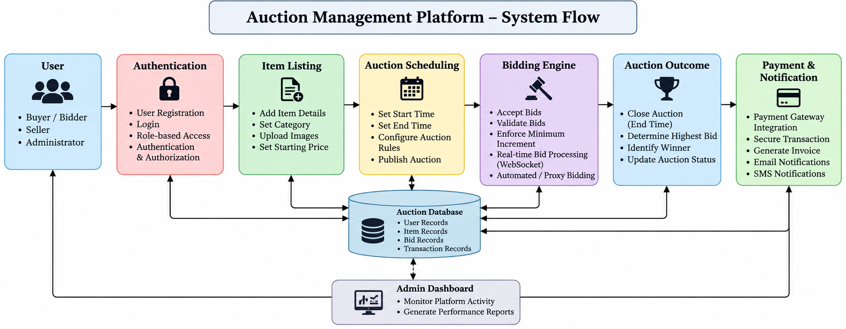
SYSTEM ARCHITECTURE

Slide 5
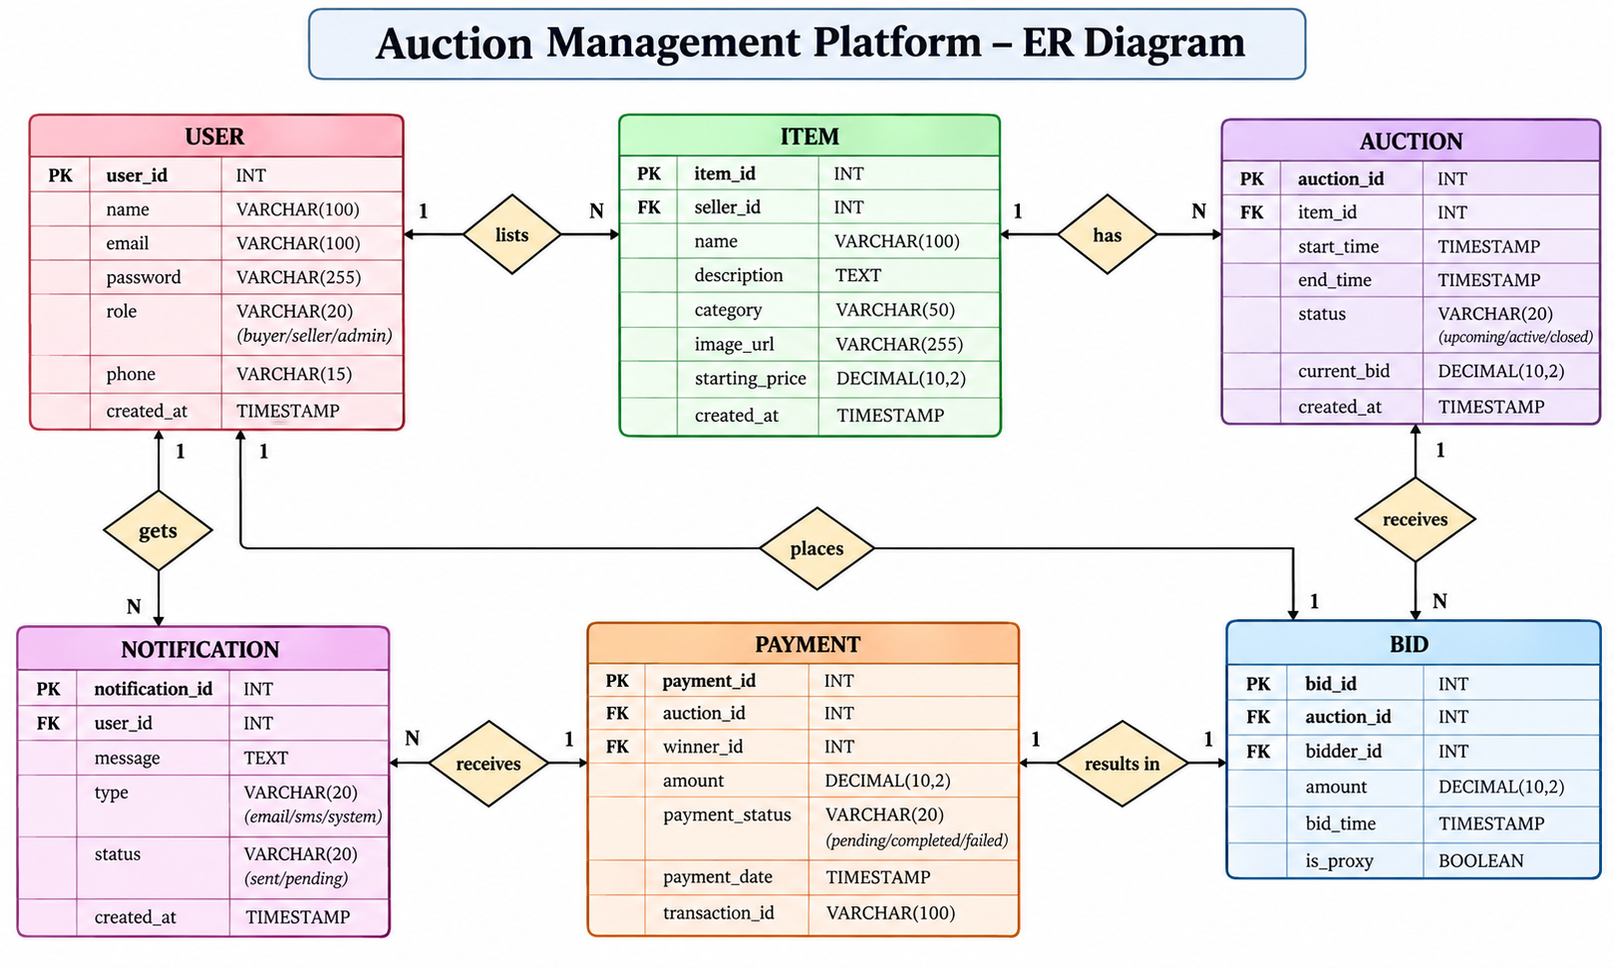
DATABASE DESIGN

Slide 6
METHODOLOGY ADOPTED
Development Methodology: Agile Approach
Development Phases:
Requirement Analysis
System Design
Database Design
User Management
Item & Auction Management
Bidding Engine Development
Payment & Notification Integration
Module Integration
Testing
Deployment
Approach:
Develop the system module by module.
Test individual modules.
Integrate modules progressively.
Perform system-level testing before deployment.

Slide 7
TECHNICAL SOUNDNESS
Frontend Technologies
React.js – User interface development
HTML5 & CSS3 – Page structure and styling
JavaScript – Client-side functionality
Axios – Communication with backend APIs
Database Technologies
MySQL – Relational database
Stores:
  User details
  Item information
  Auction details
  Bids
  Payment/transaction records
Other Technologies
JWT – Secure user authentication
Git & GitHub – Version control
Payment Gateway API – Online payment processing
Backend Technologies
Spring Boot – Backend application development
REST APIs – Frontend–backend communication
Spring Security – Authentication and role-based authorization
WebSocket – Real-time bidding communication

Slide 8
THANK YOU

